Slide 1

to our presentation

Slide 2

Team Members :
Team Name :Free Thinkers
Tamanna Akter(221-15-5298)
Mst. Fatema Akter(221-15-6015)
Suriya Akter(221-15-4745)
Abdullah Al Rifat(221-15-5954)
Md. Arif Billah(221-15-5842)

Slide 3
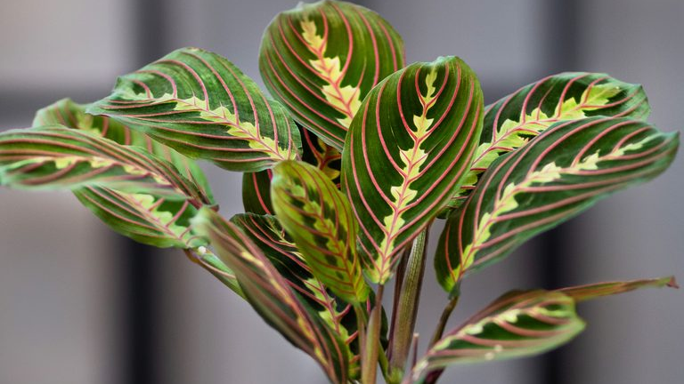
PLANT Nursery
Cultivating Green Growth

Slide 4

Company’s Name: Green Plant Nursery
Plant a Tree, Grow a Future!

Slide 5
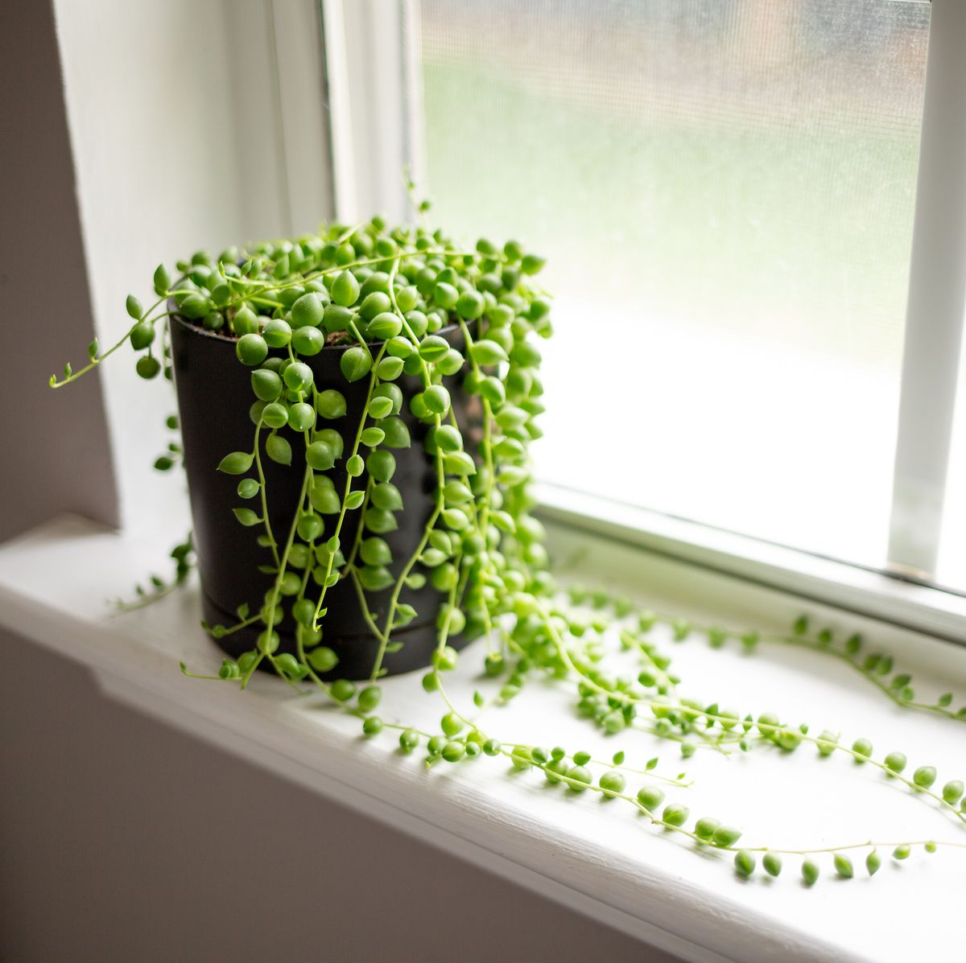

Registered nurseries-18,000
Investment - 2,000 crore tk
Involved- 5 lakh

Slide 6

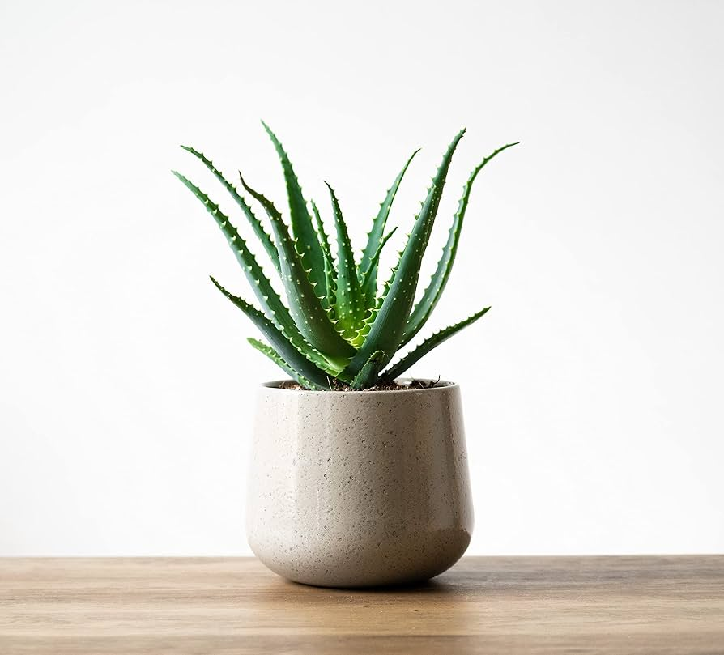
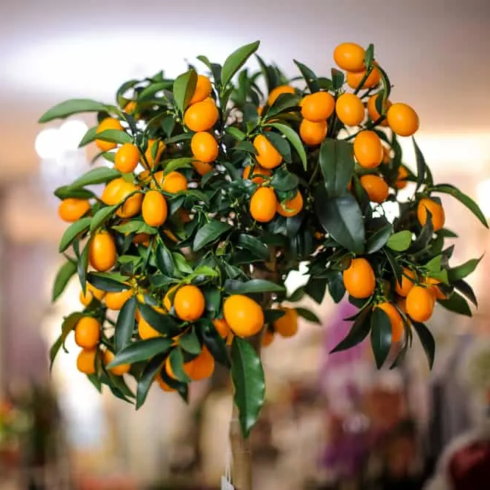
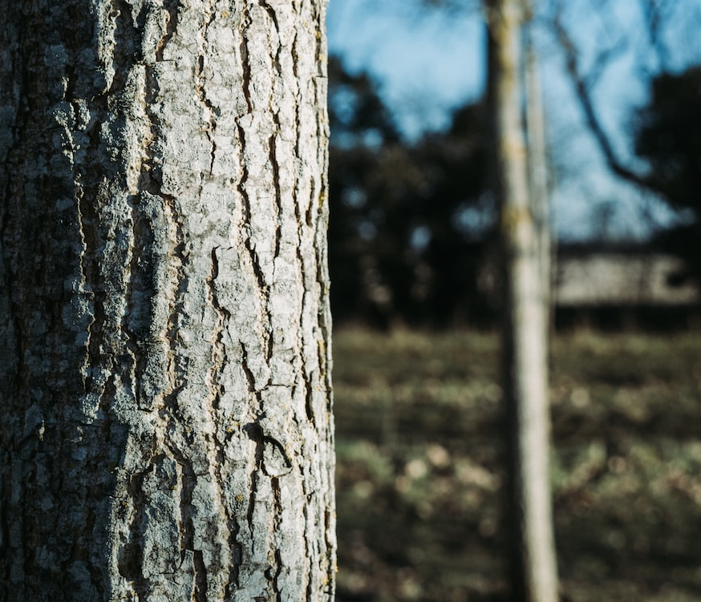
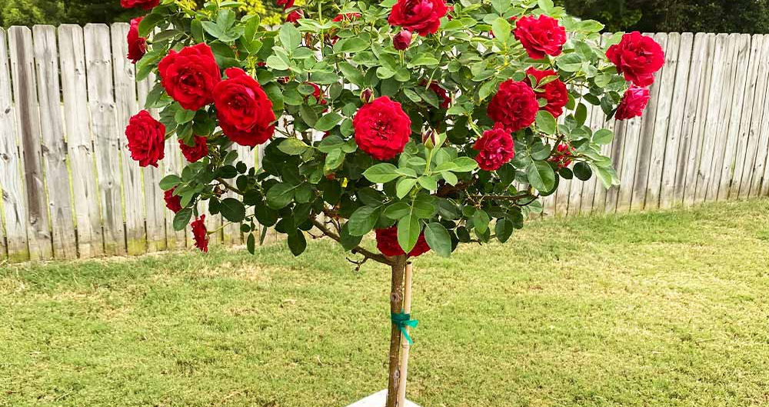
Types of plants:
Fruits
Flowers
Medicinal Plants
Indoor Plants
Wooden Trees

Slide 7

Analysis of the Production Cost:
Land – 30%
Labors –20%
Technologies-20%
Equepments –20%
Others –10%

Slide 8

How do plants nurseries contribute to the local and national economy?
Employment opportunities
Revenue generation
Biodiversity conservation
Support to agriculture field
Export potential
Tax revenue

Slide 9
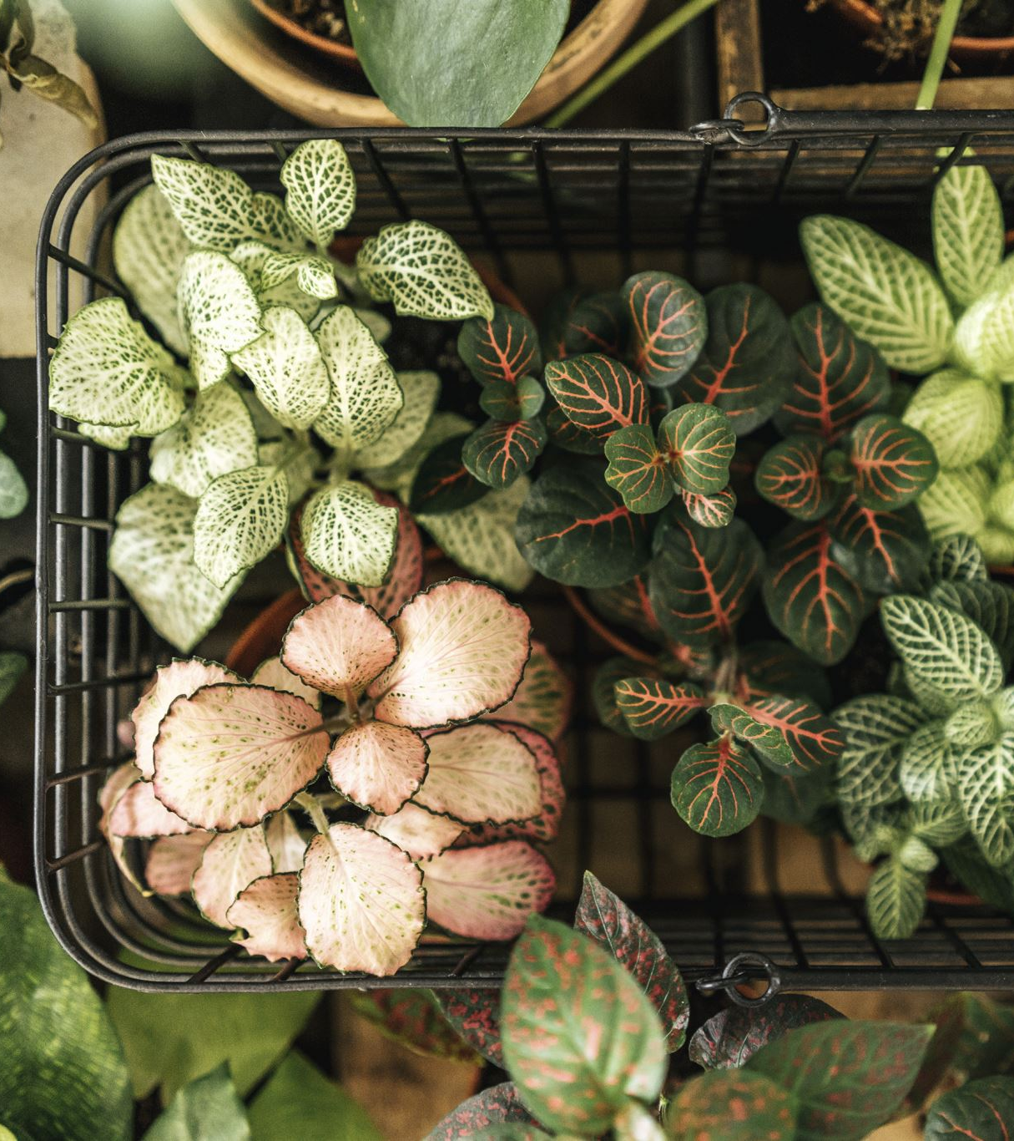
Market Trends
Increasing demand for native plants
Sustainable and organic gardening trends
Online sales and e-commerce
Changing consumer preferences
Import exotic trees.

Slide 10

Target Consumer:
Women
Various types of institutions
Pharmaceutical industry
Cosmetical industry
Students
Roof gardener
Gardener
City dwellers
Interior designer

Slide 11
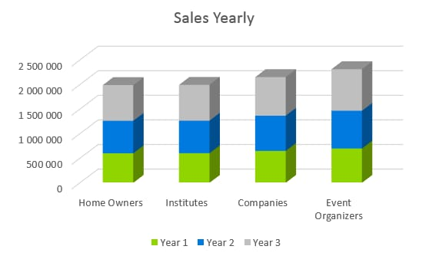
Target market:

Slide 12

Future Enhancement:
Export in International Market.
Update in Technology.
Increase Land
Online services

Slide 13


Conclusion

Slide 14

Any Question

Slide 15

Thank you

